Slide 1


Team 26: Voice-Controlled Robot
Bi-Weekly Update 3 Logan Cardwell, Dawson Holly,
Nicholas McCray, Cameron Schoenfeld Sponsor: Zhewen Hu TA: Zhewen Hu
Notes:
Michelle

Slide 2

Project Summary
The restaurant industry can be streamlined with the inclusion of automated service robots to deliver food directly to the customer without the need of human waitstaff.
The robot is able to take in voice commands and manual control from a mobile application to direct its movement while sensors detect and prevent imminent collisions. Additionally, the robot will be able to navigate through a predetermined map of the environment to quickly navigate to any marked location.
Notes:
Cameron

Slide 3
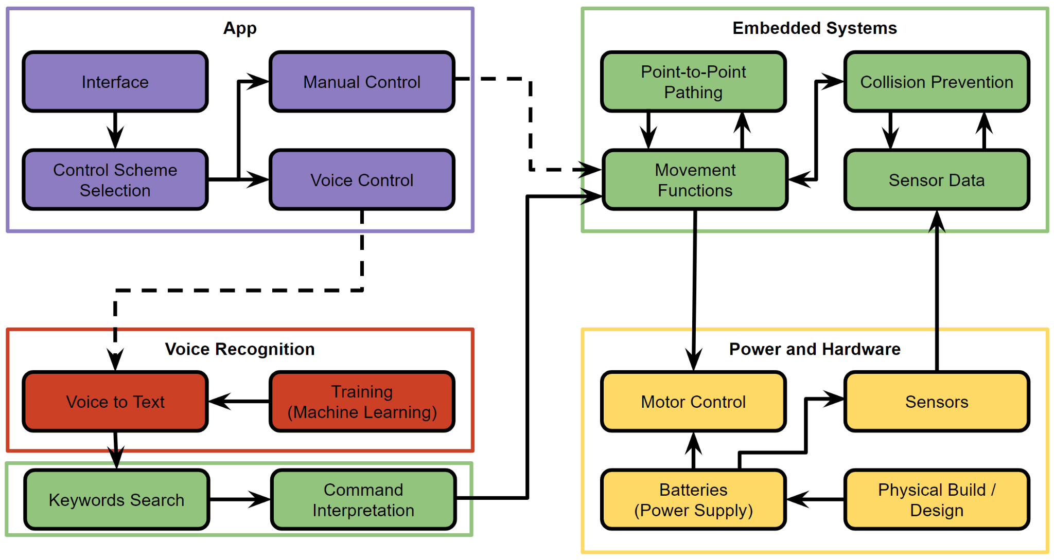
Project/Subsystem Overview
Voice Recognition: Outputs text transcription from received audio file.
Power and Hardware: Provides the required power for the motor driver and the raspberry pi.
App Design:
Receive manual and audio commands to transmit to the robot.
Embedded Systems:
Underlying logic and data flow between all other subsystems.
Logan Cardwell Dawson Holly Nicholas McCray Cameron Schoenfeld
Notes:
Dawson

Slide 4
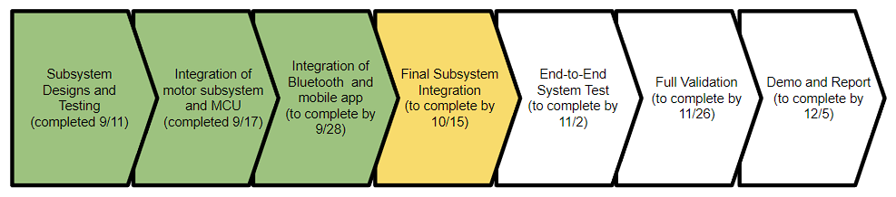
Project Timeline
Notes:
Logan

Slide 5
Voice Recognition & Body Design
Logan Cardwell
Accomplishments since last update 14 Hours of effort | Ongoing progress/problems and plans until the next presentation
A functional 300 epoch speech-to-text model has been trained. A 3D model of a body for the robot has been designed within 0.5 mm of the proportions of our chassis. | The body will be 3D printed, sanded, painted, and assembled onto the chassis of the food delivery robot. The 300 epoch STT version will replace the current, older version that currently exists on the Pi for final integration with the integrated systems subsystem
Notes:
Logan

Slide 6
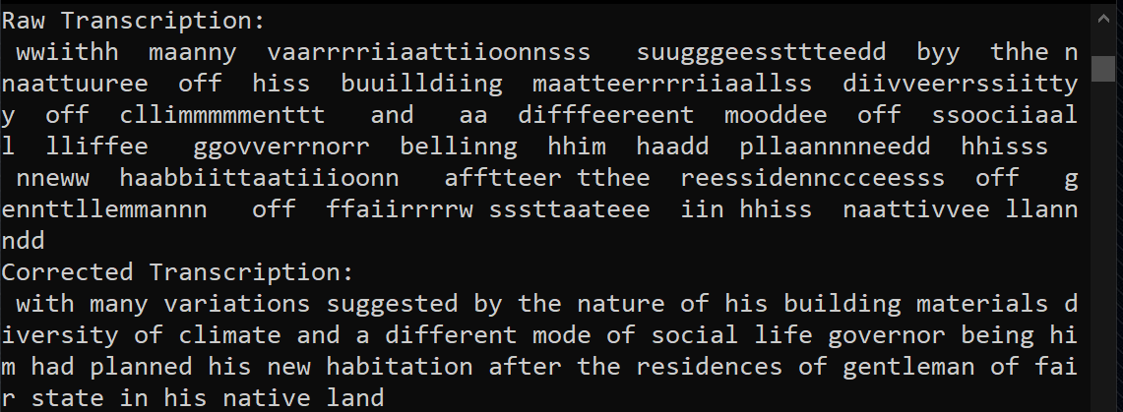
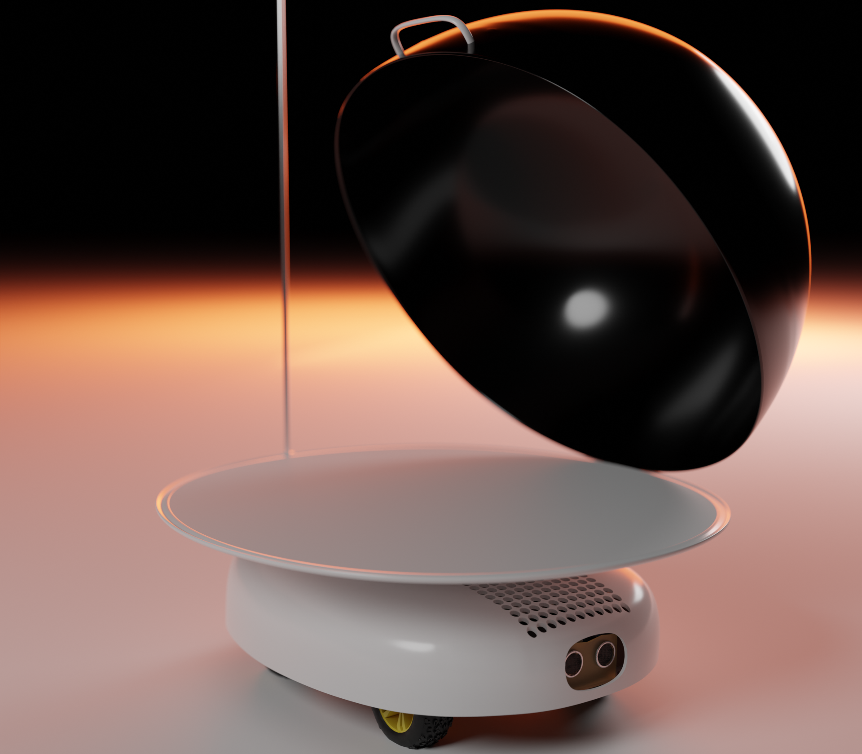
Voice Recognition & Body Design
Logan Cardwell
The 300 epoch STT system now passed validation for both valid and invalid commands. This system is functional on the Raspberry Pi.
The robots body has been designed, and features a hinged food cover, a tray with a lip to prevent spills, a grate to allow airflow to the Pi, a telescopic flag pole for visibility, and windows for the ultrasonic sensors.
Notes:
Logan

Slide 7
Power & Hardware
Dawson Holly
Accomplishments since last update 13 hrs of effort | Ongoing progress/problems and plans until the next presentation
New batteries have been installed. Final motor testing has been completed. All Power issues are resolved. Addition of a separate battery just for the Pi. Tested motor driver for all motor movement directions. Utilizing USB-C to provide Pi with power. | Test longevity and run time. Continue working on the overall robot body. Configure all connections through the 20 pin plug. Mount on/off switch. Add frame support to increase weight capacity.
Notes:
Dawson

Slide 8
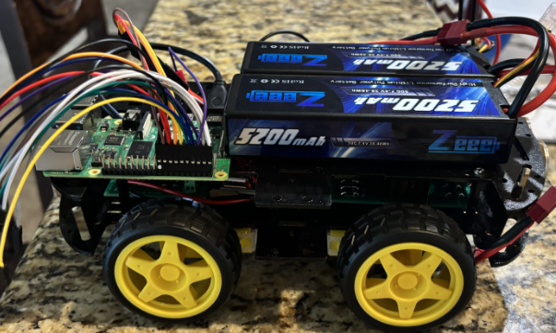
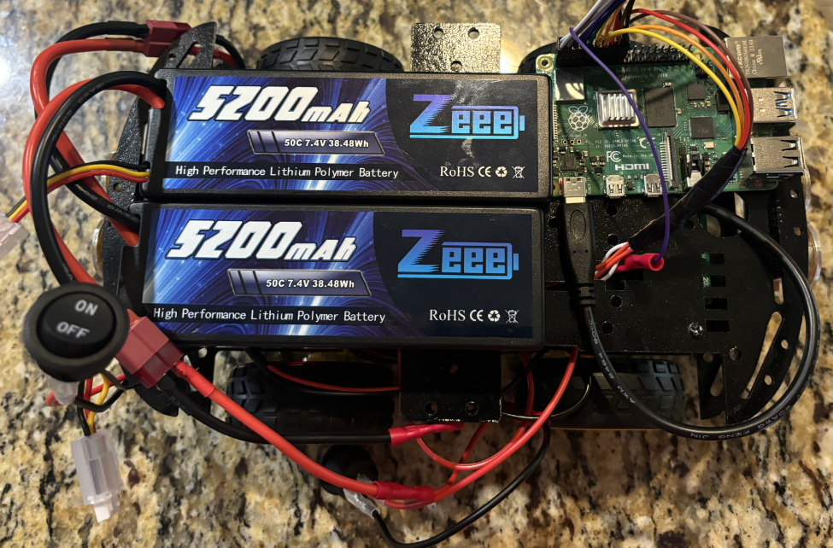
Power & Hardware
Dawson Holly
Images of the new batteries
Fully connected
Operable
Tested
The Raspberry Pi now has its own power supply.
No longer reboots unexpectedly.
Notes:
Dawson

Slide 9
App Design
Nicholas McCray
Accomplishments since last update 15 hrs of effort | Ongoing progress/problems and plans until the next presentation
Completed Raspberry Pi auto-executing forever advertising BLE script on start-up On-going app sending data to the Raspberry Pi | App sends the correct data to the Raspberry Pi App receives sensor data from the Raspberry Pi
Notes:
Nick

Slide 10
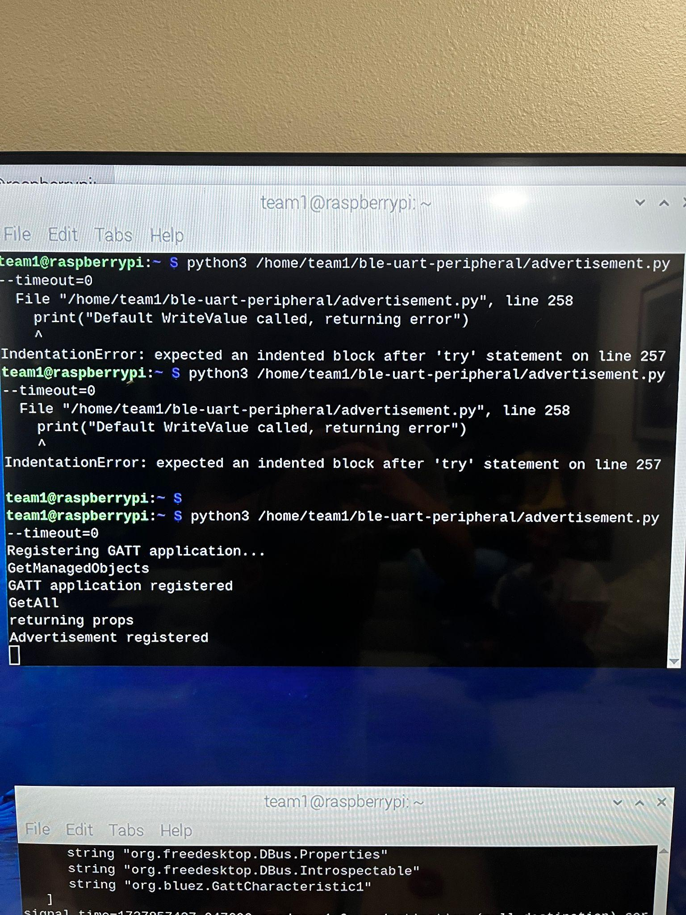
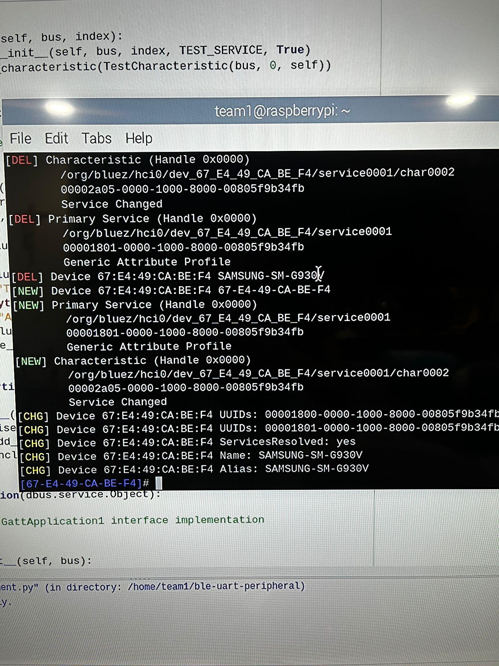
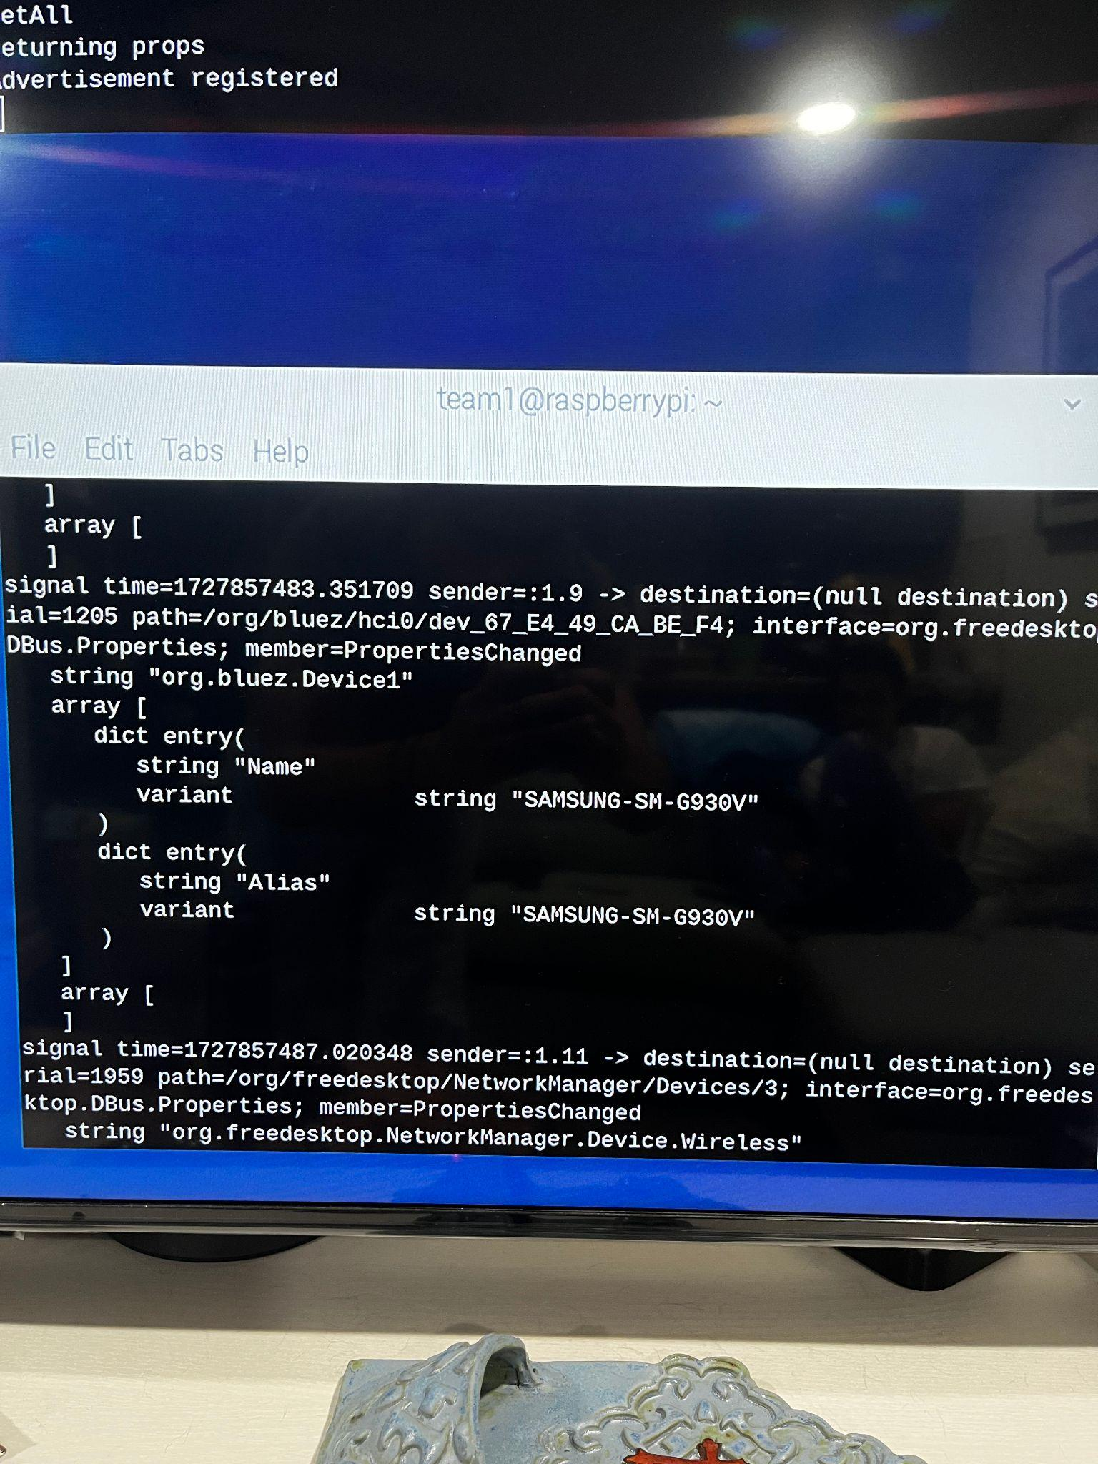
App Design
Nicholas McCray
Successful BLE program environment set up.
Device connection to Pi, device appears on the D-Bus.
Notes:
Nick

Slide 11
Embedded Systems
Cameron Schoenfeld
Accomplishments since last update 12 hrs of effort | Ongoing progress/problems and plans until the next presentation
Rebuilt basic pathing algorithm with the A* model. Created virtual ‘Test map’ to run the program through. Added ‘Go to’ command to navigate to marked points in the test map. Successful virtual pathfinding from any marker on map to any other marker. | Complete integration of voice recognition subsystem. Complete object avoidance when pathing to markers.
Notes:
Cameron

Slide 12
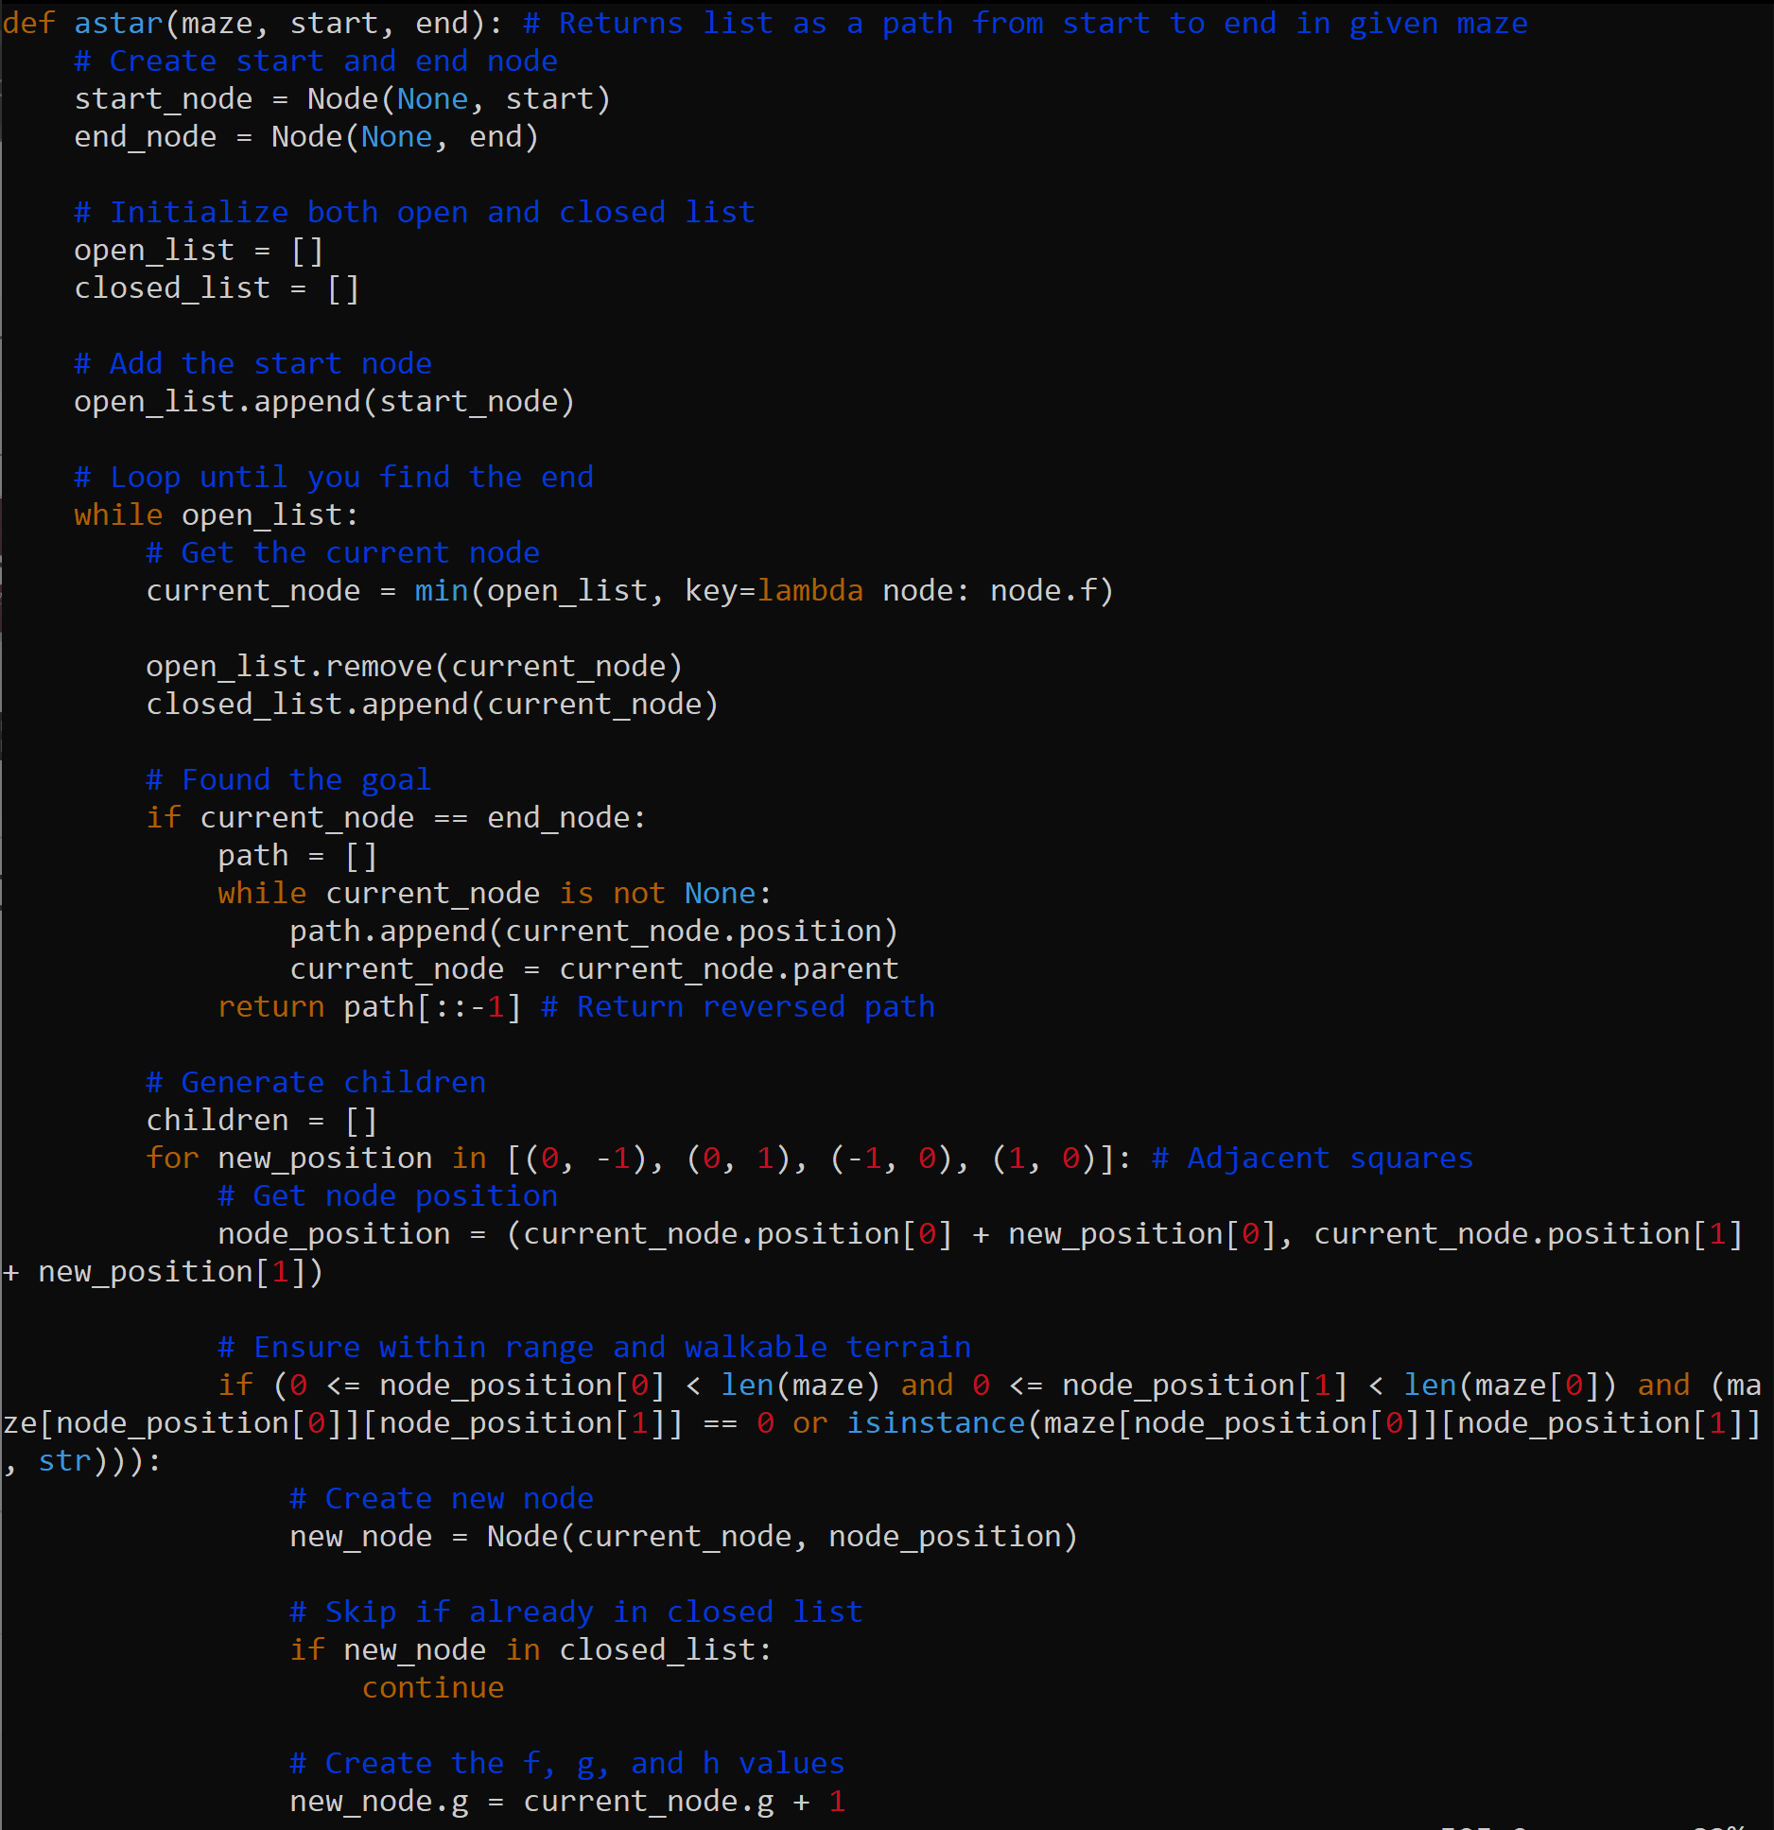
Embedded Systems
Cameron Schoenfeld
Portion of the A* Pathing algorithm, modified for our use.
Additional functions for directing the motors to follow the shortest found path.
Notes:
Cameron

Slide 13
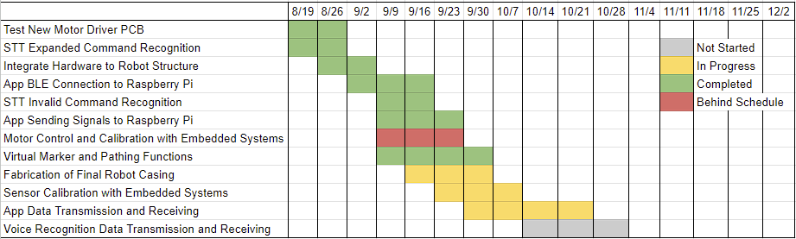
Execution Plan
Notes:
Michelle

Slide 14
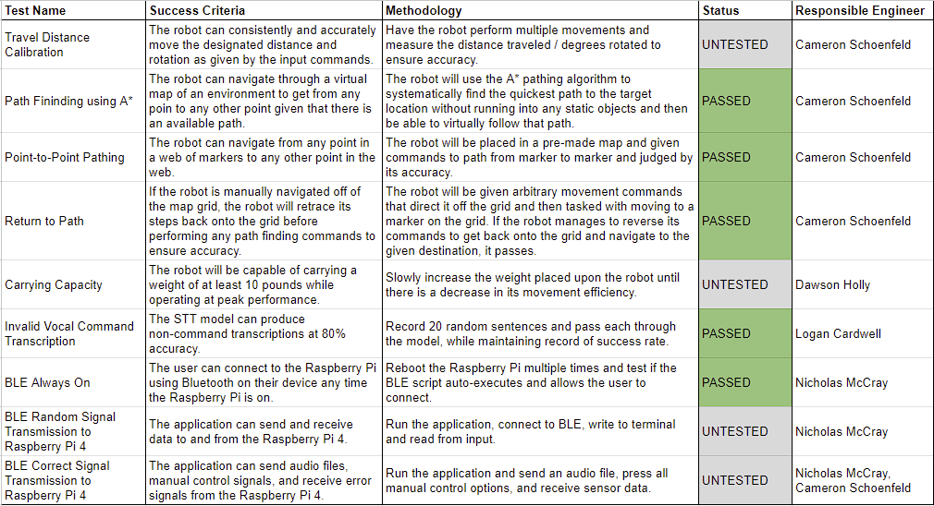
Validation Plan
Notes:
Michelle

Slide 15
Thank You!
Any Questions?

